Slide 1
How to Become A Software Engineer
By Calvin C
Presented by Tony Nguyen

Slide 2
Overview
Take a free, online Intro to CS Course
Learn on freeCodeCamp
Learn Version Control & Use Code Editors
Build Small Projects
Learn Data structures & Algorithms
Work on Bigger Projects
Apply to Jobs & Internships

Slide 3
Step 1: Intro to CS Courses
To get a feel if you like CS
Plenty of free resources:
  MIT Open Courseware
    https://www.youtube.com/watch?v=nykOeWgQcHM&list=PLUl4u3cNGP63WbdFxL8giv4yhgdMGaZNA
  Harvard CS50 Intro to CS
    https://online-learning.harvard.edu/course/cs50-introduction-computer-science?delta=0

Slide 4
Step 2: freeCodeCamp Courses
https://www.freecodecamp.org/learn
I recommend going through:
  Responsive Web Design
  JavaScript Data Structures & Algorithms
  Front-End Development
  API & Microservices

Slide 5
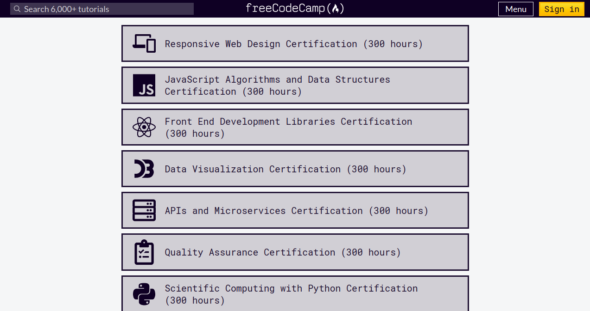

Slide 6
Step 3: Version Control & Code Editors
Version Control
  Helps to control different versions of a project
  Most popular one everyone uses is Git
Code Editors
  Place to write code. Have useful functions as well
  I recommend using Visual Studio Code for beginners

Slide 7

Step 4: Build Small Projects
This was where I built a bunch of small, crappy projects
Example to the left, Oreo Clicker

Slide 8
Step 5: Data Structures & Algorithms
The beard and butter of CS
Helps you to prepare for coding interviews
Good resource:
  https://www.coursera.org/learn/algorithms-part1

Slide 9
Step 6: Work on Bigger Projects
Build your own big project or work on an open source program on GitHub

Slide 10
Step 7: Apply to Jobs & Internships
Yeah! Congrats. Now time for the job hunt
Now you have the basic knowledge and some projects under your belt
Create a resume and add all this in and start applying!

